Slide 1



Indian Agriculture
Mentorness
Mohd Danish

Slide 2

Introduction
At the heart of our exploration lies a robust dataset teeming with a plethora of agricultural variables. Spanning a wide spectrum of crops including staples like rice and wheat to niche produce such as millets and pulses, the dataset encapsulates crucial information on crop areas, production quantities, and yields. Each data point is meticulously curated, providing granular insights into the agricultural dynamics unfolding across India's diverse districts and over multiple years. From the lush paddy fields of Punjab to the arid terrains of Rajasthan, our dataset traverses the length and breadth of the country, offering a holistic perspective on the agricultural tapestry of India.

Slide 3


Dataset Description
The dataset encompasses a wide range of agricultural variables, including crop areas, production quantities, and yields for different crops such as rice, wheat, sorghum, millets, pulses, oilseeds, sugarcane, and more.

Slide 4
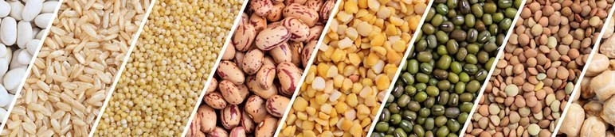
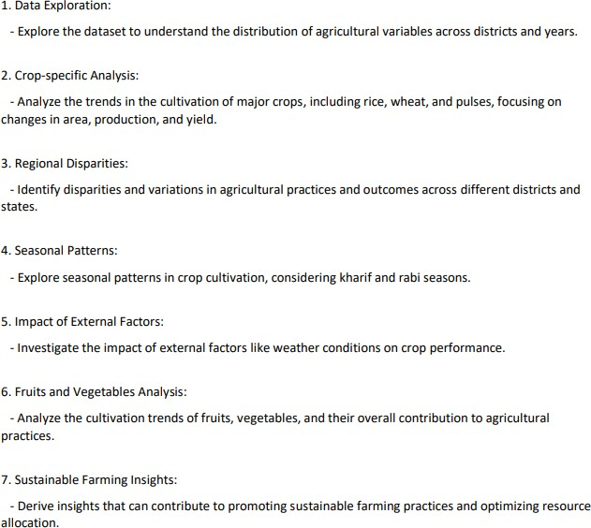
Project Objectives
01

Slide 5
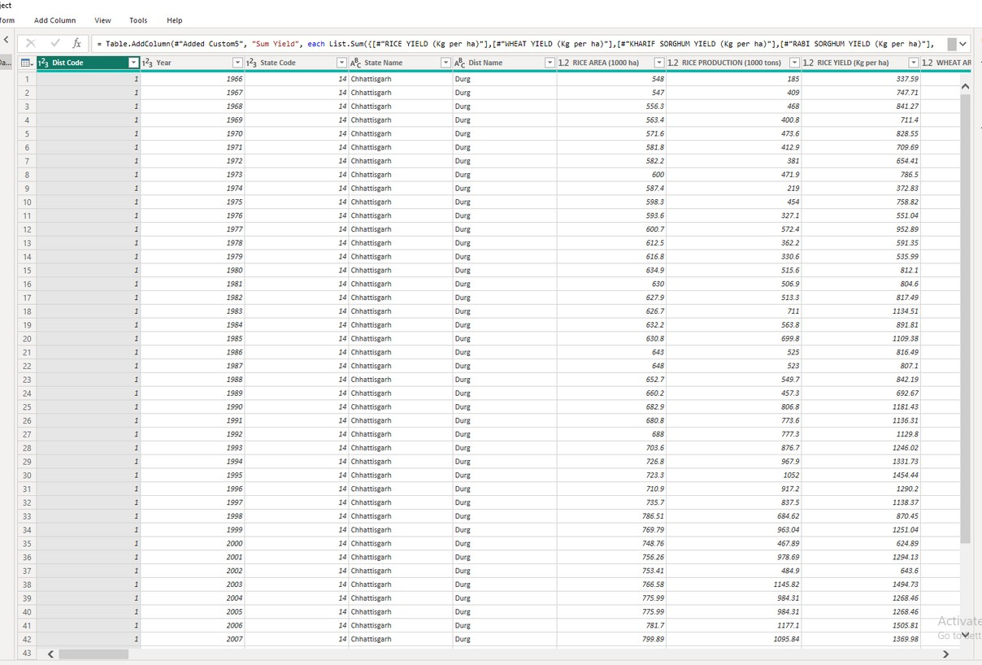
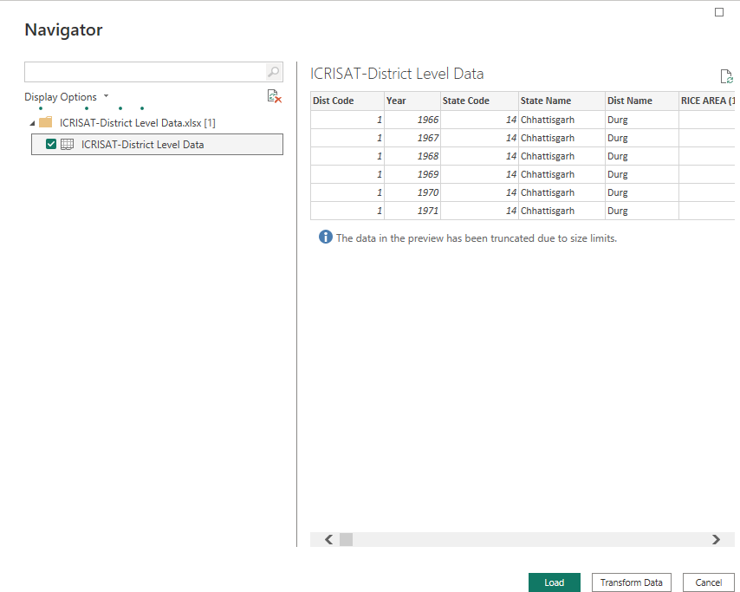
Data Set
Import Data Set

Slide 6
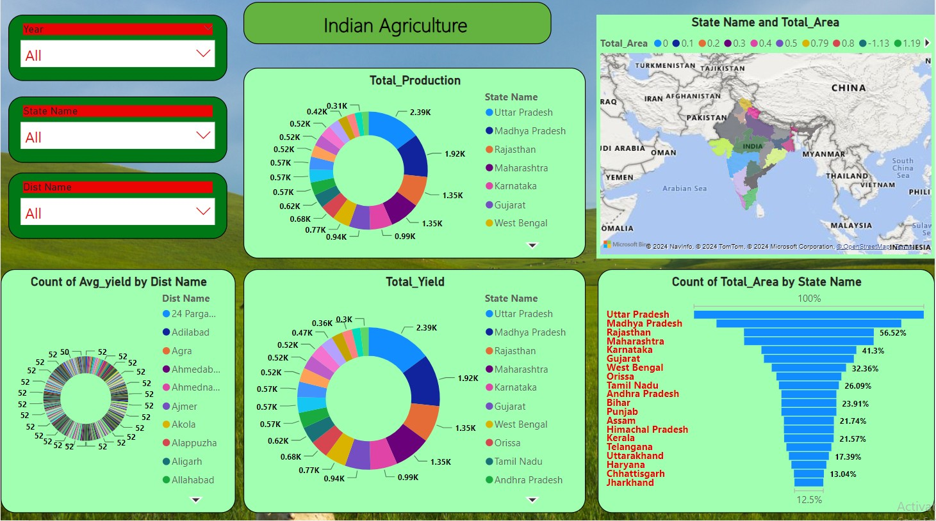
Dashboard

Slide 7
Summary
The Indian agriculture project aims to transform the agricultural sector by leveraging technology, knowledge, and partnerships to address the challenges faced by smallholder farmers and promote sustainable and inclusive growth. Farmers can make informed decisions to enhance productivity and resilience in there operations.
Mohd Danish
Batch Name: MIP-DA-04

